Slide 1


Flask API
Data Engineering I Cloud I IoT I Mobile I Enterprise AI
I Integrity I Intellect I Ingenuity

Slide 2
APIs ? What are API’s ?
API stands for “Application Programming Interface.” An API is a software intermediary that allows two applications to talk to each other.
API is the messenger that delivers your request to the provider that you’re requesting it from and then delivers the response back to you.
Classic example of API’s is Google Maps APIs which communicate with server to pull customized location data, send directions, and analyze all types of location data.
API’s allow real time communication with the server applications to send/receive data.

Slide 3
Types of API’s
REST API’s – A representational state transfer, is a type of software design that gives access to data by using a uniform and predefined set of operations(get,put,update,delete) and json/xml as response types.
SOAP API’s – Simple Object Access Protocol is a bit more complex than REST because it requires more information upfront about security and how it sends messages, it uses XML format for communication.
Browser API’s/ Mobile API’s – Browser/Mobile has its own set of APIs that provides developers the tools to build experiences for their end users.

Slide 4

Framework for building web api’s in python
Can you give me the list of users myfantasticsite.com?
Here you go!
web applications in Python
Hello world
GET https://myfantasticsite.com
The web application (server)
The browser (client)
Hello world

Slide 5
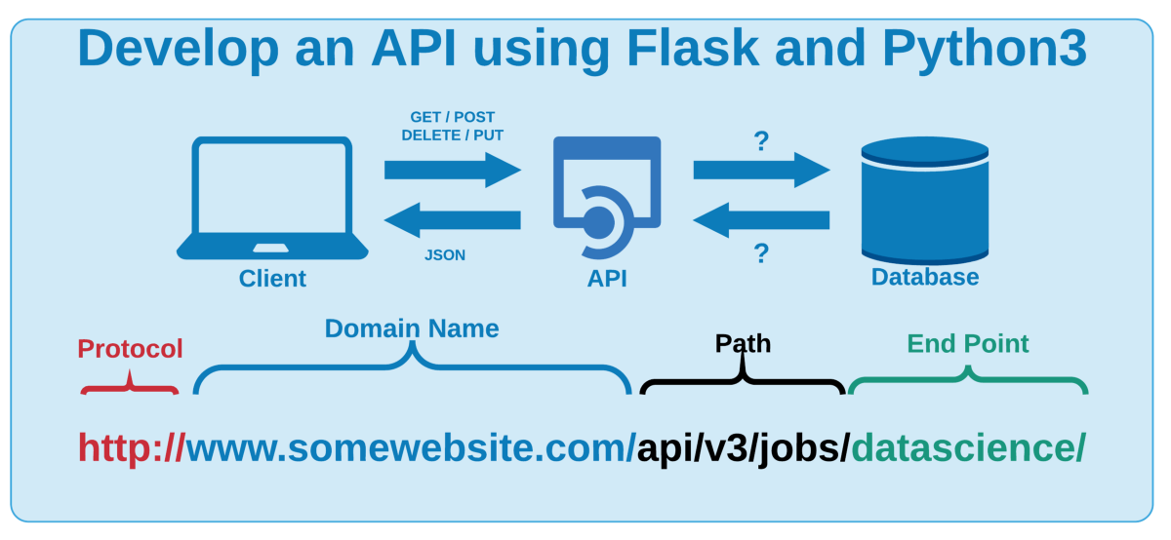
Flask API Flow

Slide 6
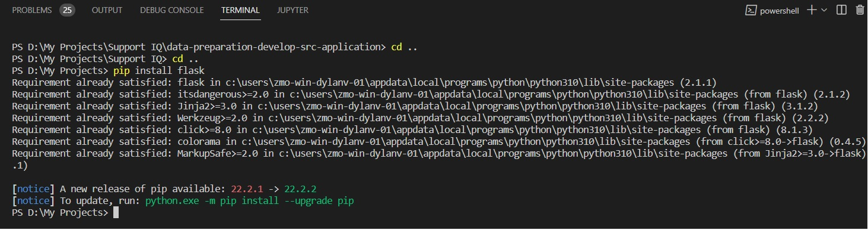
Prerequisites
Python v3.0
Install python package using installer for windows, packaes for linux or others os’s
Python comes with pip to install all python dependencies
pip install package name

Slide 7
Before Writing a Flask Application
Install Flask
Python comes with a package manager called pip
Install flask
pip install flask

Slide 8
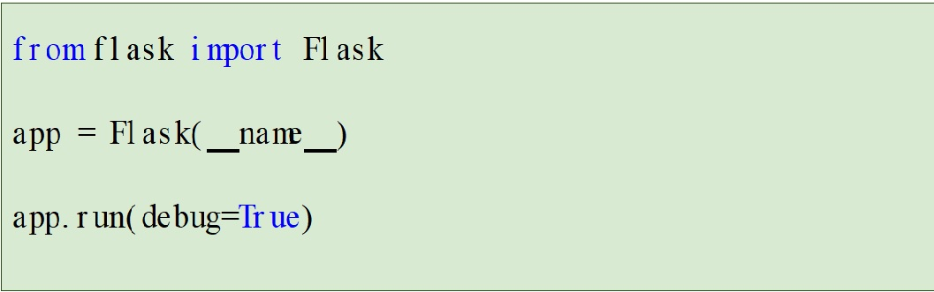
Writing your first Flask application
Create a file called main.py in your project directory . . .
. . . and edit it in your favorite text editor and write below code

Slide 9
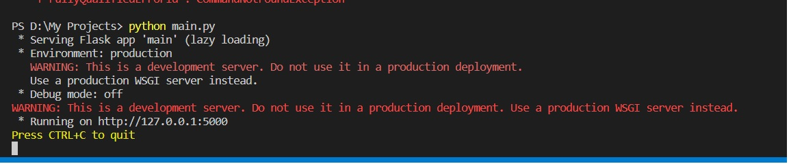
Running your Flask application
Run main.py, and visit http://localhost:5000/ in your browser
Note the /. That’s the route

Slide 10
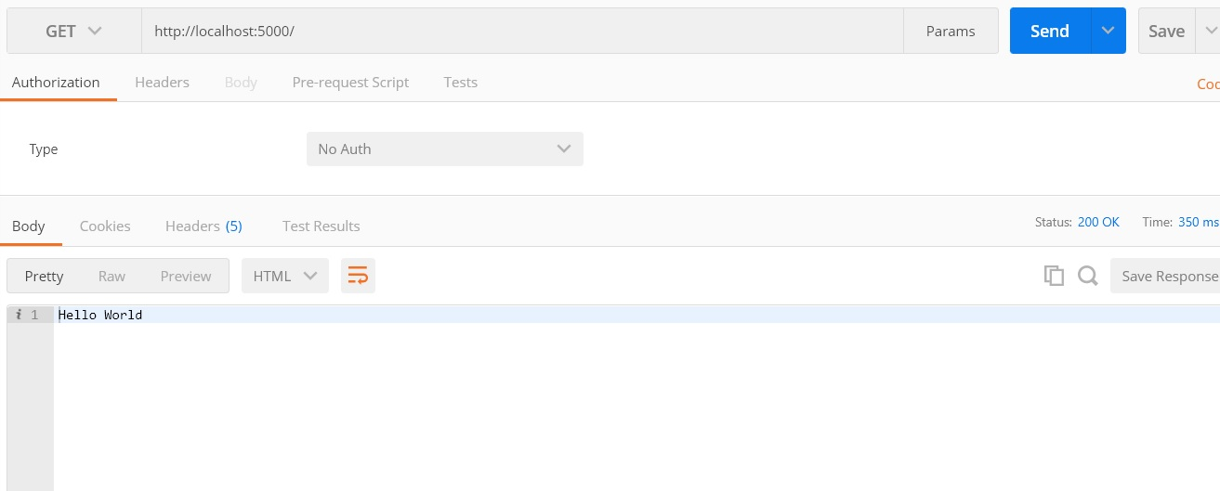
Go to browser/Postman to test the api

Slide 11
Defining Routes
The web server is running at http://localhost:5000, but you didn’t tell it what to return when someone visits the / route
To do that, you have to add a function for the / route
Flask uses Python decorators to define routes
There can be any number of routes in your application

Slide 12
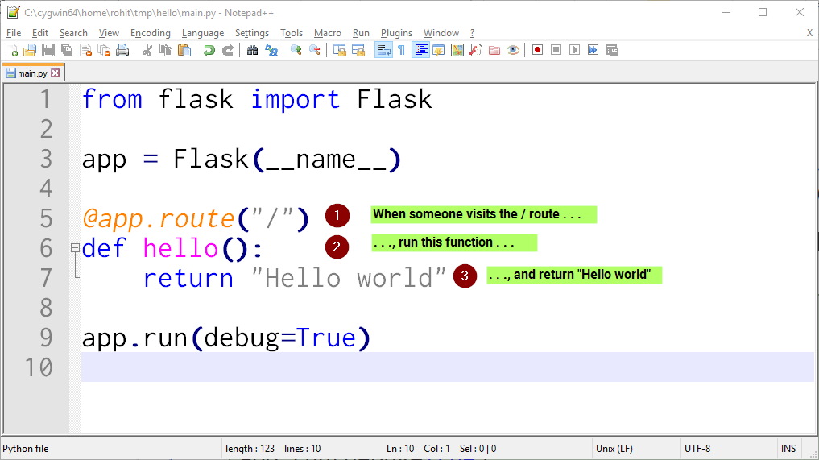
Defining Routes

Slide 13
How to test?
Using tools like
Postman
Insomnia
Browser – Only Get requests
Curl commands
Swagger UI
Open API 3.0 specification
https://swagger.io/tools/swagger-ui/

Slide 14
Dealing with Data
You can either connect to Database (mysql,sqlite,oracle,postgres etc)
Read from files (CSV,excel,txt)
Return hardcoded data from list, tuple etc

Slide 15
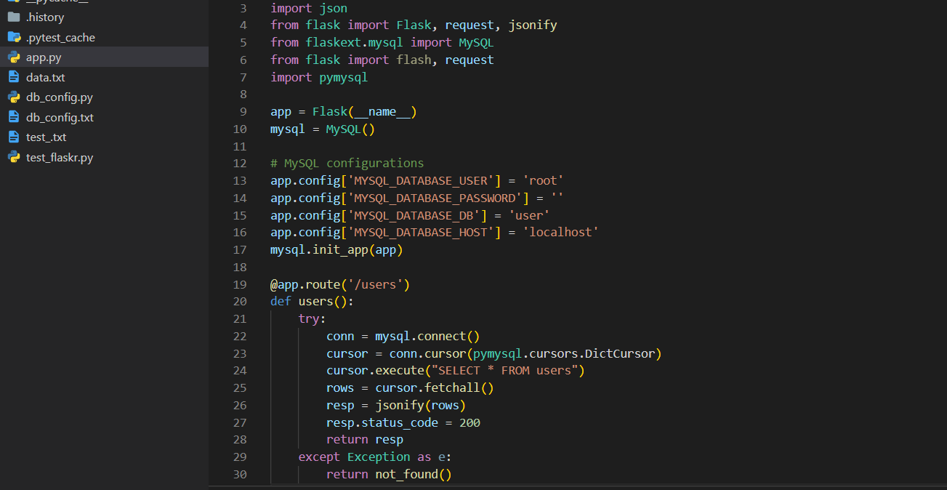
Connecting to Database
You can use mysql.connector for connecting to mysql db
Similarly use psycopg2 for connecting to postgres db

Slide 16
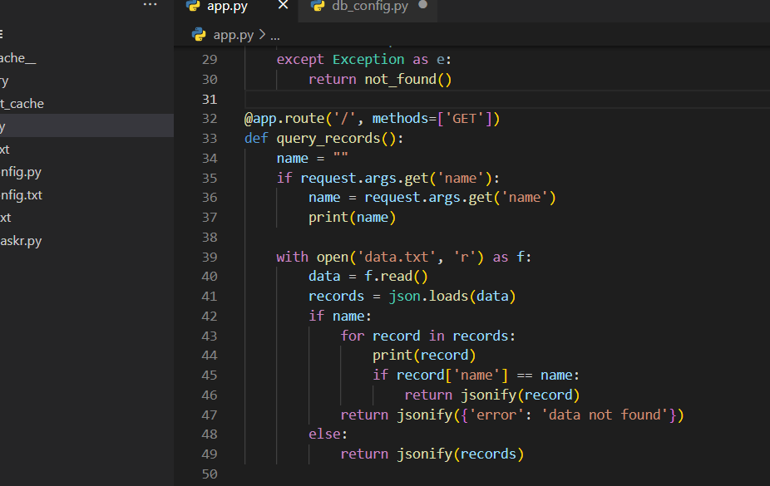
Reading/Writing data from file
You can use text, json file for storing data
Read or write to file and return json data

Slide 17
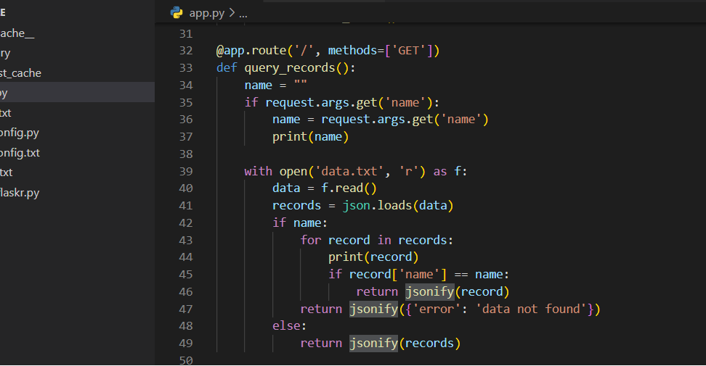
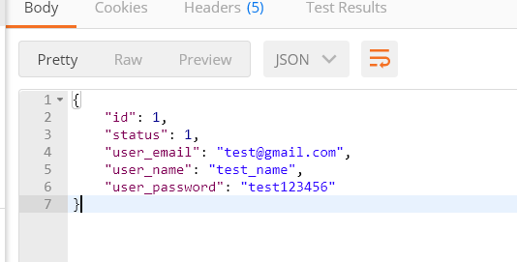
Dealing with json
You can use json package of python to read/write json data
You can use jsonify to build json data

Slide 18
Unit testing flask api’s
Unit testing focuses on the parts of a program rather than the whole.
Break the program into all its little pieces, each of which has well-defined behavior.
You can use unittest extension of flask.
Also you can use pytest extension of flask.
Create client for each test case and perform unit testing.

Slide 19
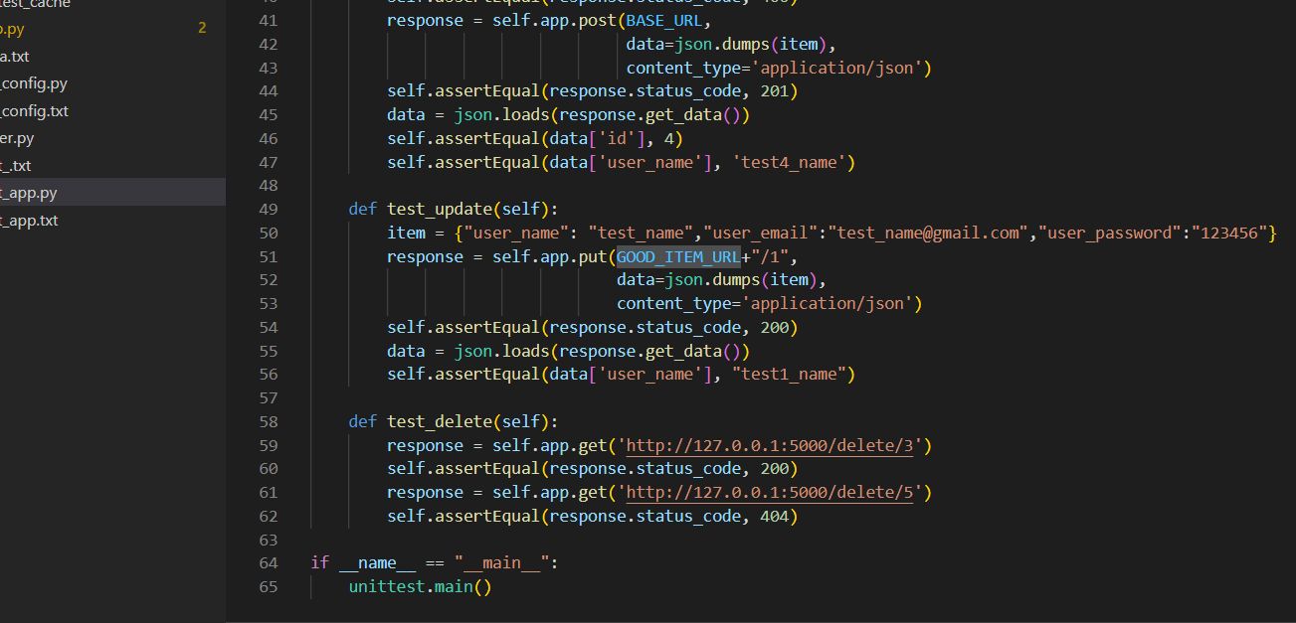
Unit testing flask api’s
Use unittest extension of flask for unit testing, create test_app.py for creating unit test cases.

Slide 20
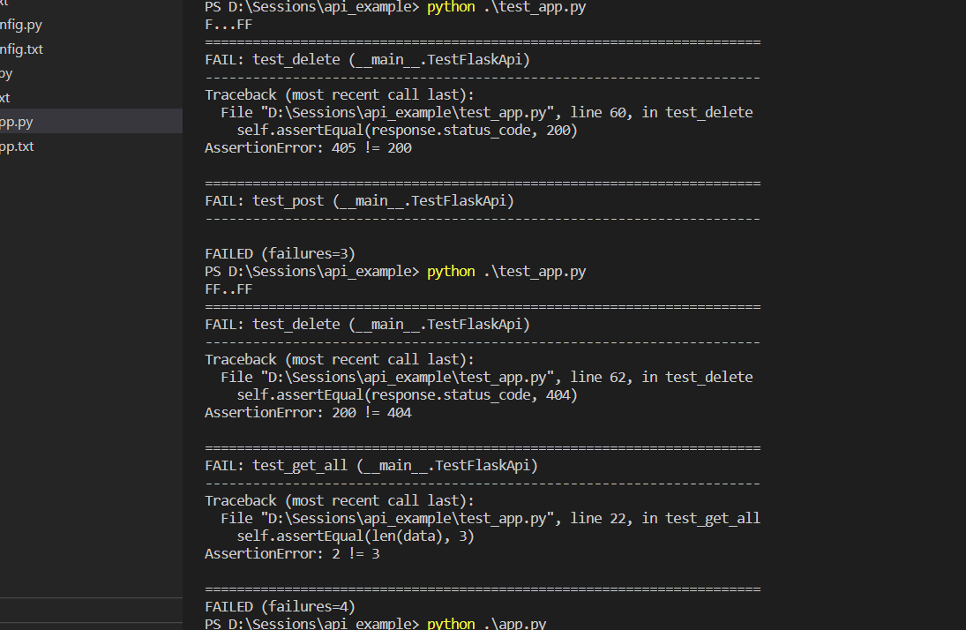
Unit testing flask api’s
Run unittest program as python test_app.py

Slide 21
Exercise
Add missing validations in the api’s
Use sqlalchemy orm for db
Explore and implement session in api’s
Add pandas data frame
Use webforms
Explore jinja template

Slide 22
Thank you!

